Slide 1

Predicting Hospital Readmission
BST260 Final Project
Jacob Rosenthal, Selena Huang, Jonathan Waring, Erica Moreira

Slide 2
Agenda
Abstract
Background
Data Description
Problem Statement
Data Cleaning
Exploratory Data Analysis
Methodology
Discussion and Results
Conclusions
Limitations

Slide 3
Abstract
Goal: Investigate predictors of hospital readmissions for diabetes patients
Methods: XGBoost, kNN, GLMnet
Results: Healthcare utilization (number of inpatient, outpatient, and emergency encounters) is the most important factor in predicting readmission for diabetes patients
Conclusion: The complexities of predicting hospital readmission require that data be collected in a thoughtful way so that a complete picture of a person’s health can be captured

Slide 4
Background
What is a 30 day hospital readmission?
All-cause unplanned readmissions that happen within 30 days of discharge from the index (i.e., initial) admission
Patients who are readmitted to the same hospital, or another applicable acute care hospital for any reason
Why are hospital readmissions important?
Reducing hospital readmissions is a national priority
Hospital Readmissions Reduction Program (Centers for Medicaid & Medicare Services)
Why are hospital readmissions for diabetes patients important?
Diabetes status in hospitalized patients has a significant bearing on outcome, in terms of both morbidity and mortality
30.3 million people have diabetes in the U.S. (9.4% of the population) [2]

Slide 5
Data Description
Data source: Health Facts database (Cerner Corporation, Kansas City, MO)
National data warehouse that collects comprehensive clinical records across hospitals throughout the United States
Health Facts is a voluntary program offered to organizations which use the Cerner Electronic Health Record System
Data systematically collected from participating institutions electronic medical records
Includes encounter data (emergency, outpatient, and inpatient), provider specialty, demographics (age, sex, and race), diagnoses and in-hospital procedures documented by ICD-9-CM codes, laboratory data, pharmacy data, in-hospital mortality, and hospital characteristics
All data were deidentified in compliance with the Health Insurance Portability and Accountability Act of 1996 (HIPAA)

Slide 6
Data Description
The dataset we used is a subset of the data in the Health Facts database that represents 10 years (1999-2008) of clinical care at 130 US hospitals and integrated delivery networks.
It includes over 50 features representing patient and hospital outcomes. Information was extracted from the Health Facts database for encounters that satisfied the following criteria:
It is an inpatient encounter (a hospital admission)
It is a diabetic encounter, that is, one during which any kind of diabetes was entered to the system as a diagnosis
The length of stay was at least 1 day and at most 14 days
Laboratory tests were performed during the encounter
Medications were administered during the encounter
Link to data source: https://archive.ics.uci.edu/ml/datasets/Diabetes+130-US+hospitals+for+years+1999-2008

Slide 7
Problem Statement
The problem is a 2-way classification task in which we try to predict if a patient will have:
1. No readmission within 30 days
2. Readmission within <30 days

Slide 8
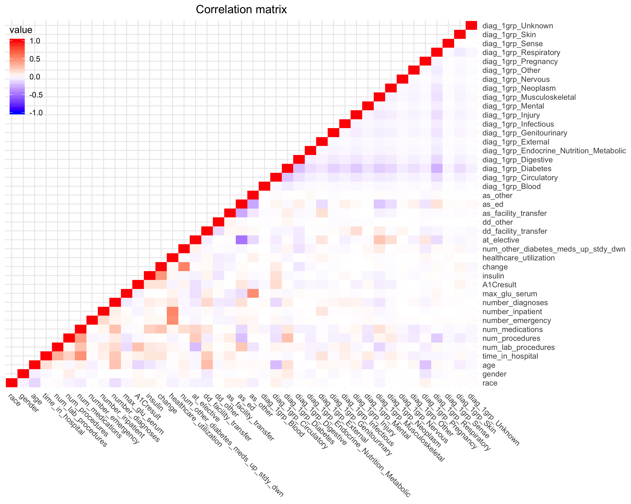
Data Cleaning
Removed variables that were:
Unnecessary
Redundant
Missing too many values
Created new variables:
Healthcare Utilization: sum of outpatient, inpatient, emergency encounters
Number of diabetes medications
Grouped diagnoses based on Strack et al. 2014 paper (see References slide)
Result: Clean dataset
Correlation Matrix for Final Dataset

Slide 9
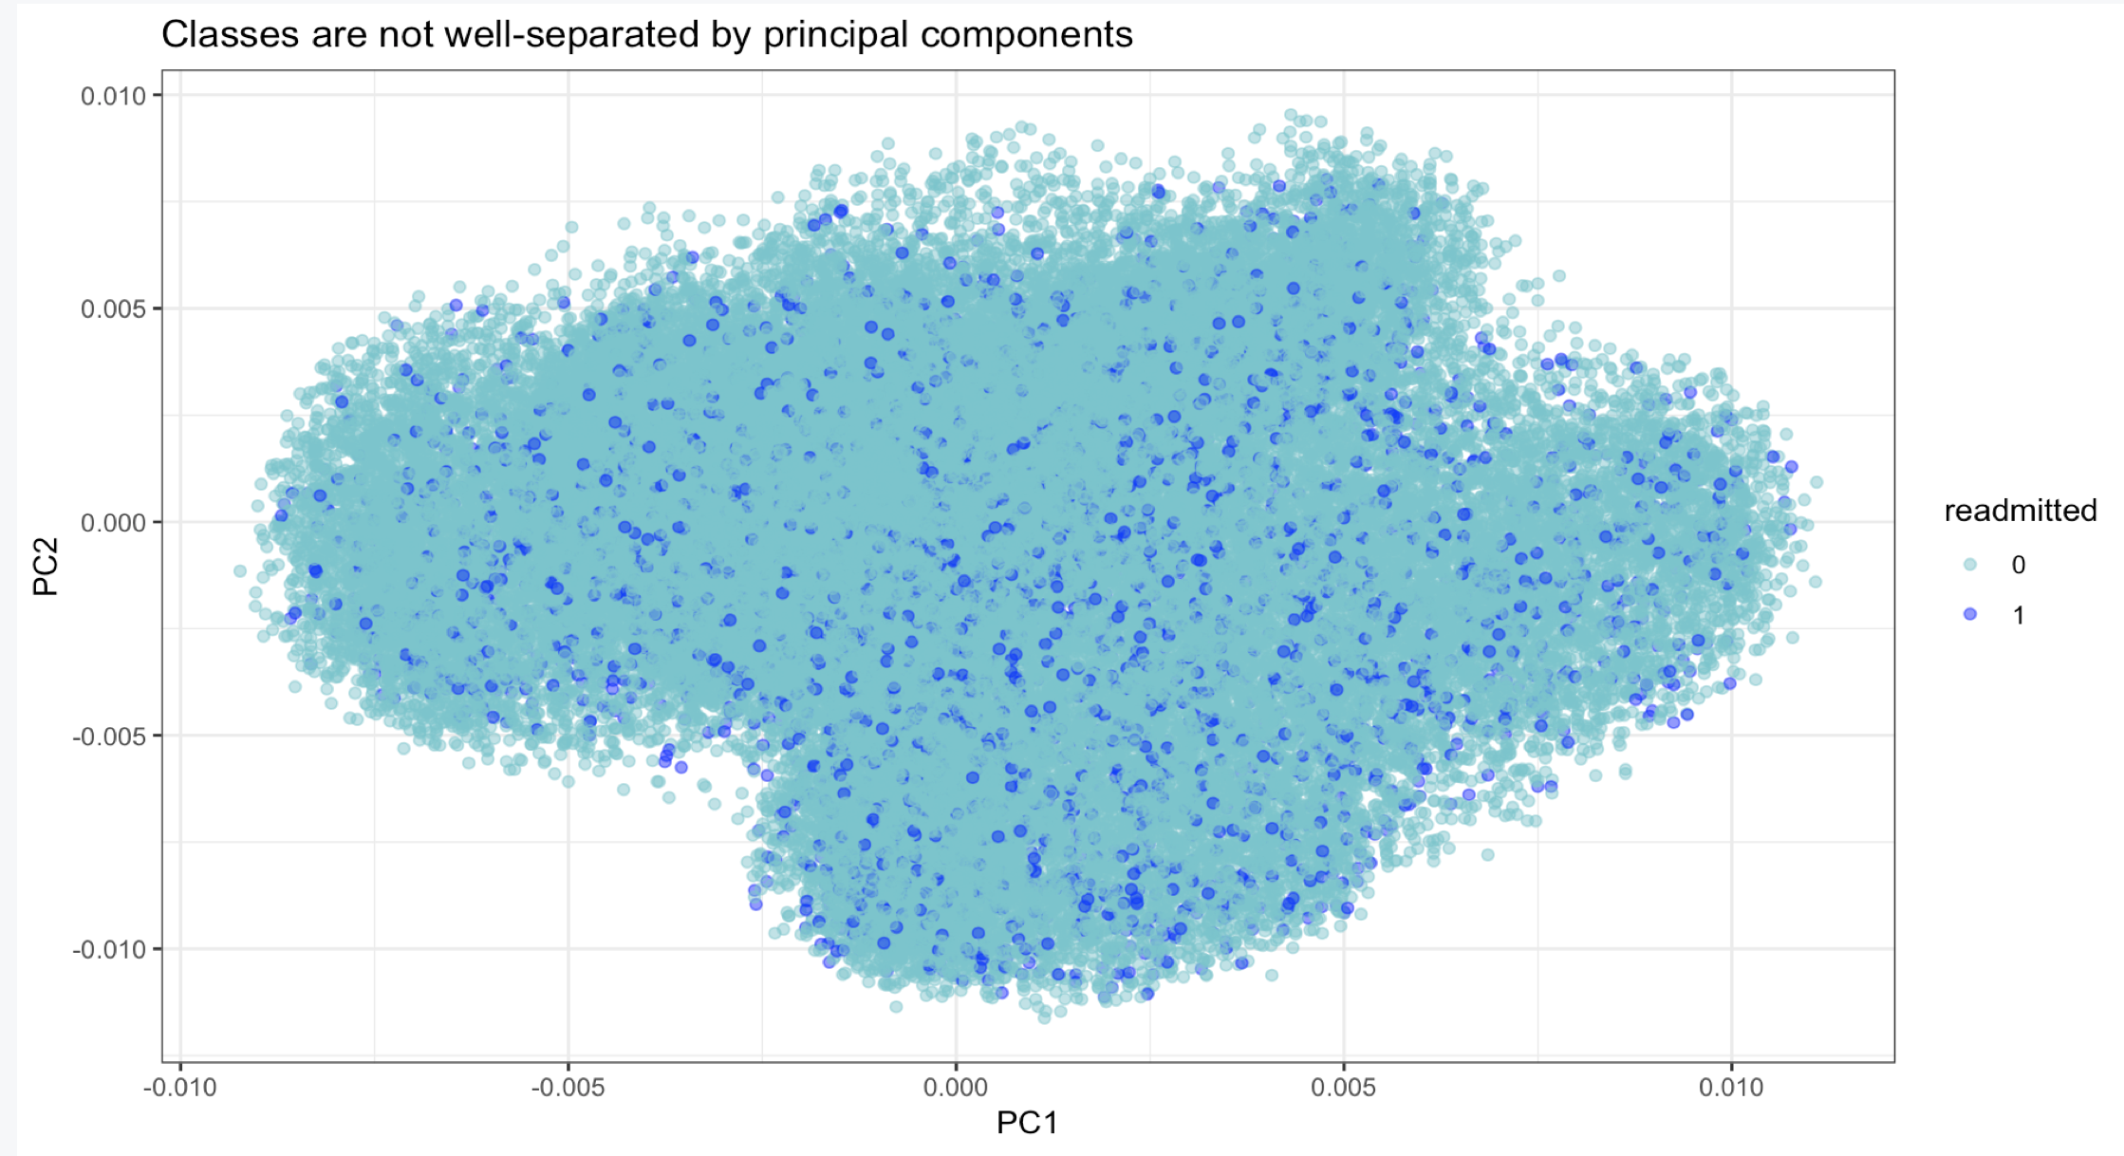
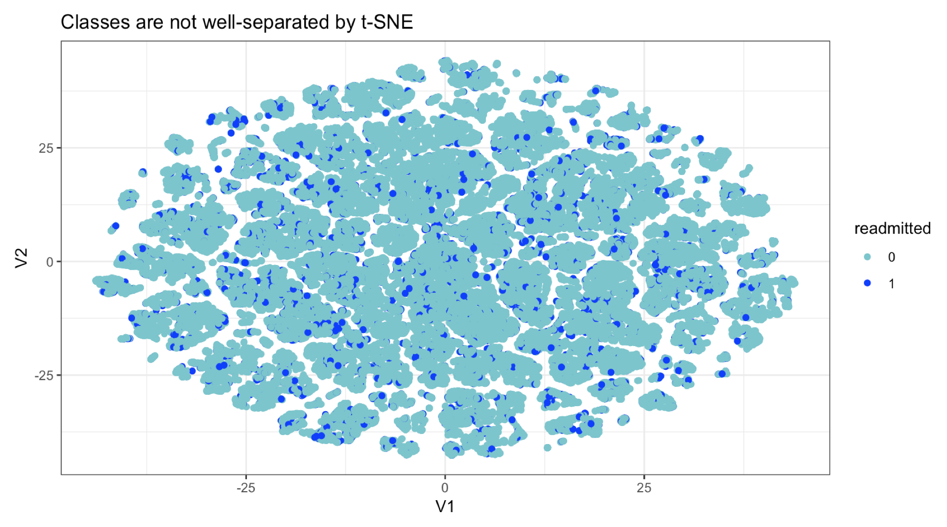
Exploratory Data Analysis
PCA
t-SNE
Notes:
Principal component analysis and analysis using a (t-SNE) dimensionality reduction algorithm showed that our two readmission classes are not well separated.

Slide 10
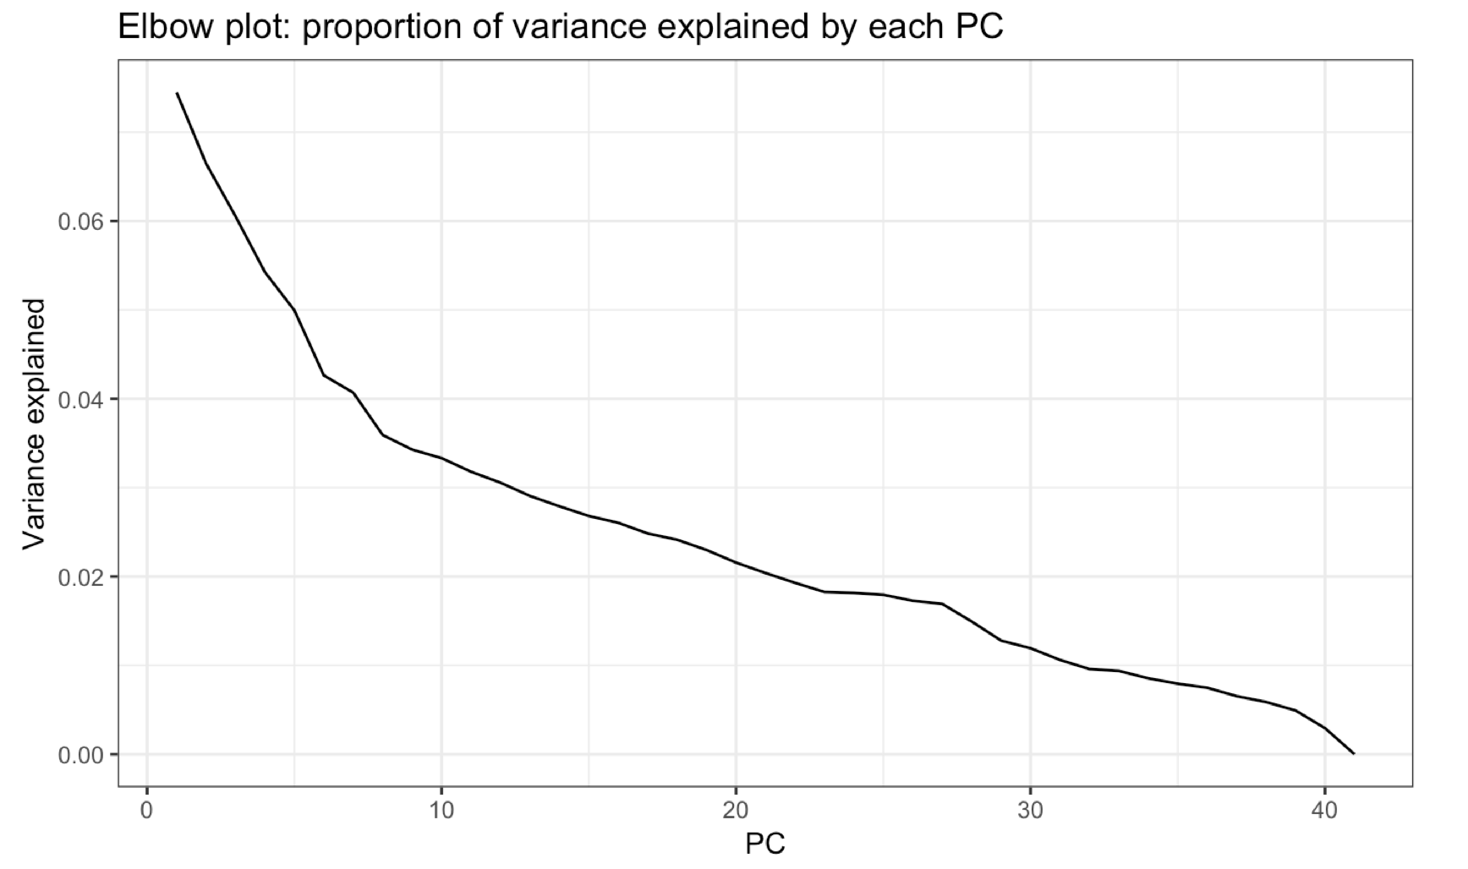
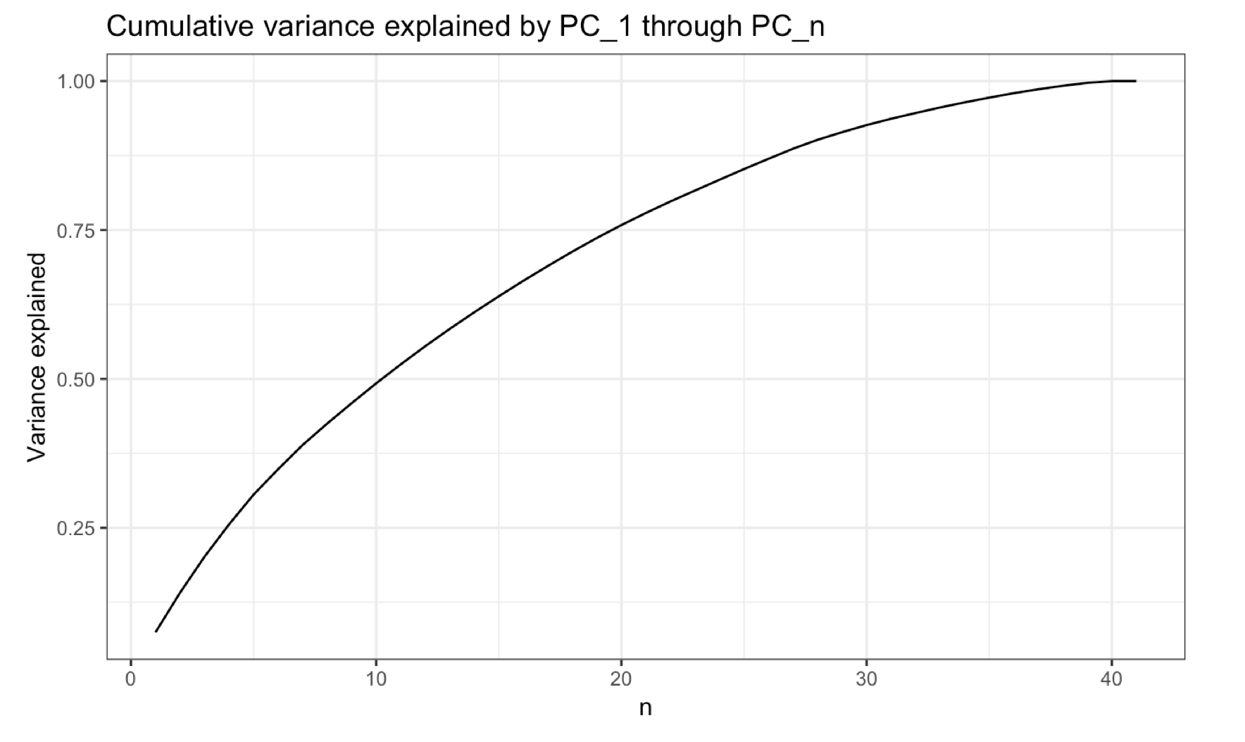
Exploratory Data Analysis
Notes:
The first few principle components did NOT explain a large percentage of the variance.

Slide 11
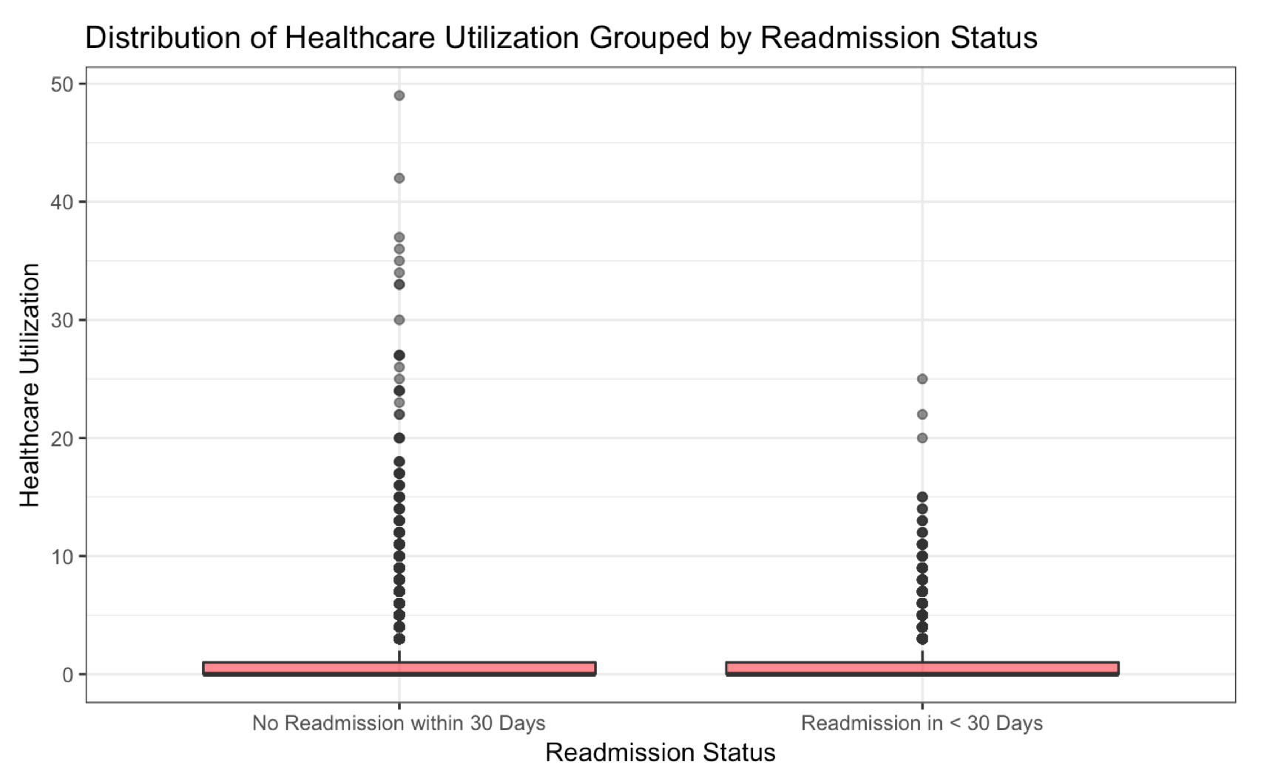
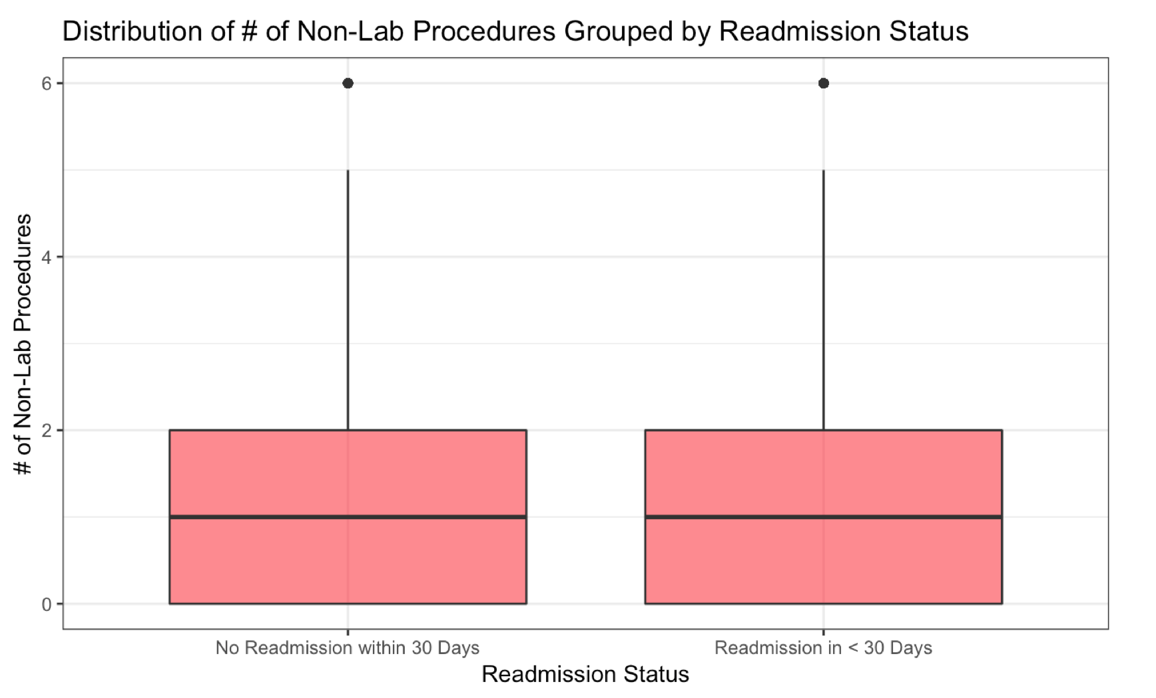
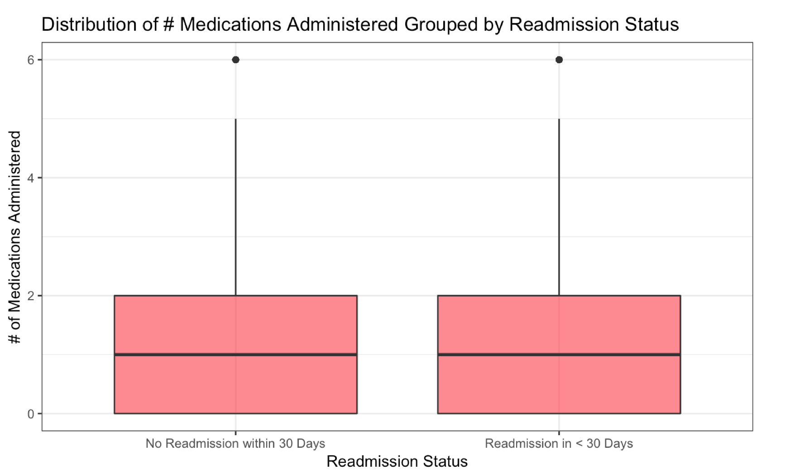
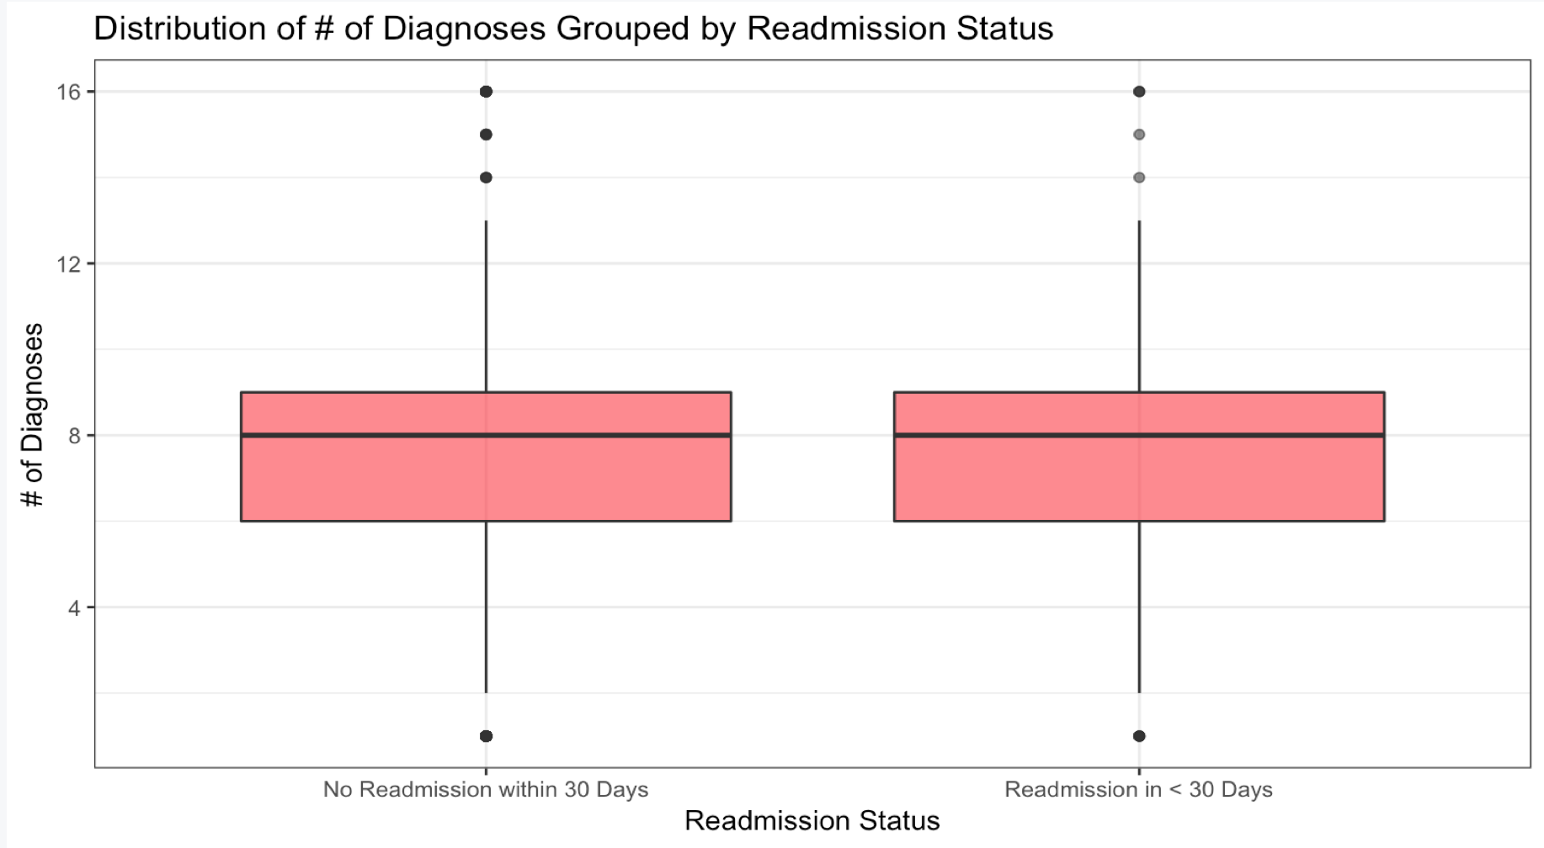
Exploratory Data Analysis
Notes:
Exploratory data analysis showed very little separation between the readmission classes. Variables we expected to be significantly different between our two readmission classes were surprisingly NOT.

Slide 12
Methodology
Input variables: 41
Output variable: readmission class
Total sample size: 70,420
Partition: 80% on training, 20% on testing
Build Models From:
XGBoost
kNN
GLMnet
Solution: SMOTE Algorithm For Unbalanced Classification Problems
Notes:
Our final model included 41 input variables and a sample size of 70k, 80% on training and 20% on testing. We built models using …

Slide 13
Methodology
Problem: unbalanced classes
Solution: SMOTE Algorithm For Unbalanced Classification Problems
Readmission within <30 days | No readmission within 30 days
64129 (91.1%) | 6291 (8.9%)
Notes:
We addressed our unbalanced classes problem using the SMOTE algorithm
We used the SMOTE oversampling method to balance our data-set without as much overfitting. This does not prevent all overfitting, however, as the new instances are still created from existing data points.

Slide 14
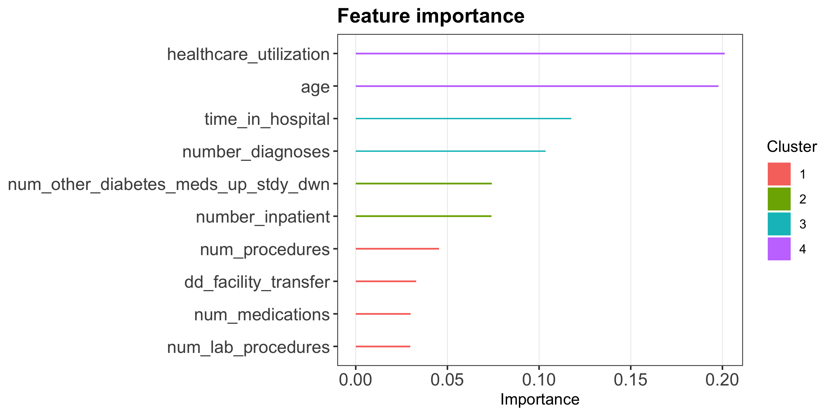
Discussion and Results
Method: XGBoost
Notes:
Our XG boost model showed that our most important variables are…

Slide 15
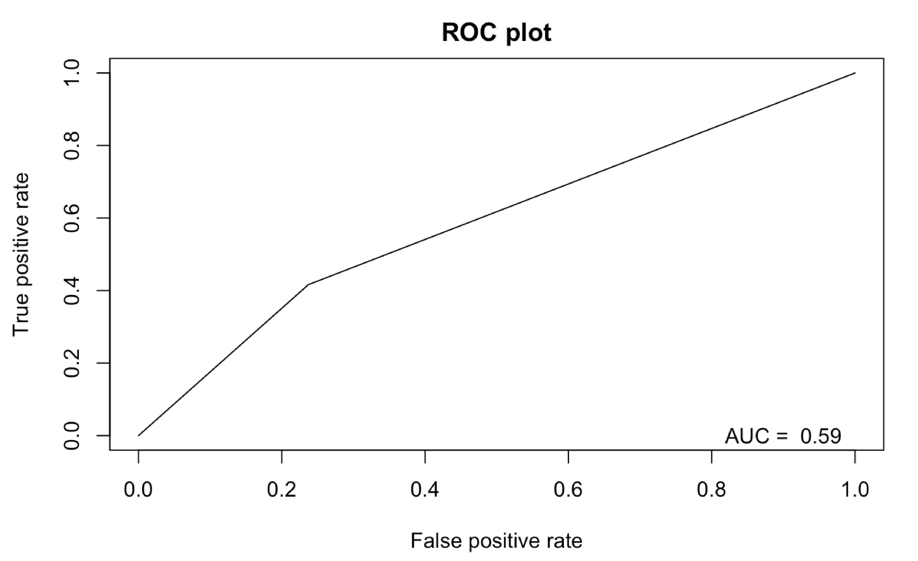
Discussion and Results
Method: XGBoost
Notes:
We first implemented XGBoost, which resulted in an AUC of 0.59.

Slide 16
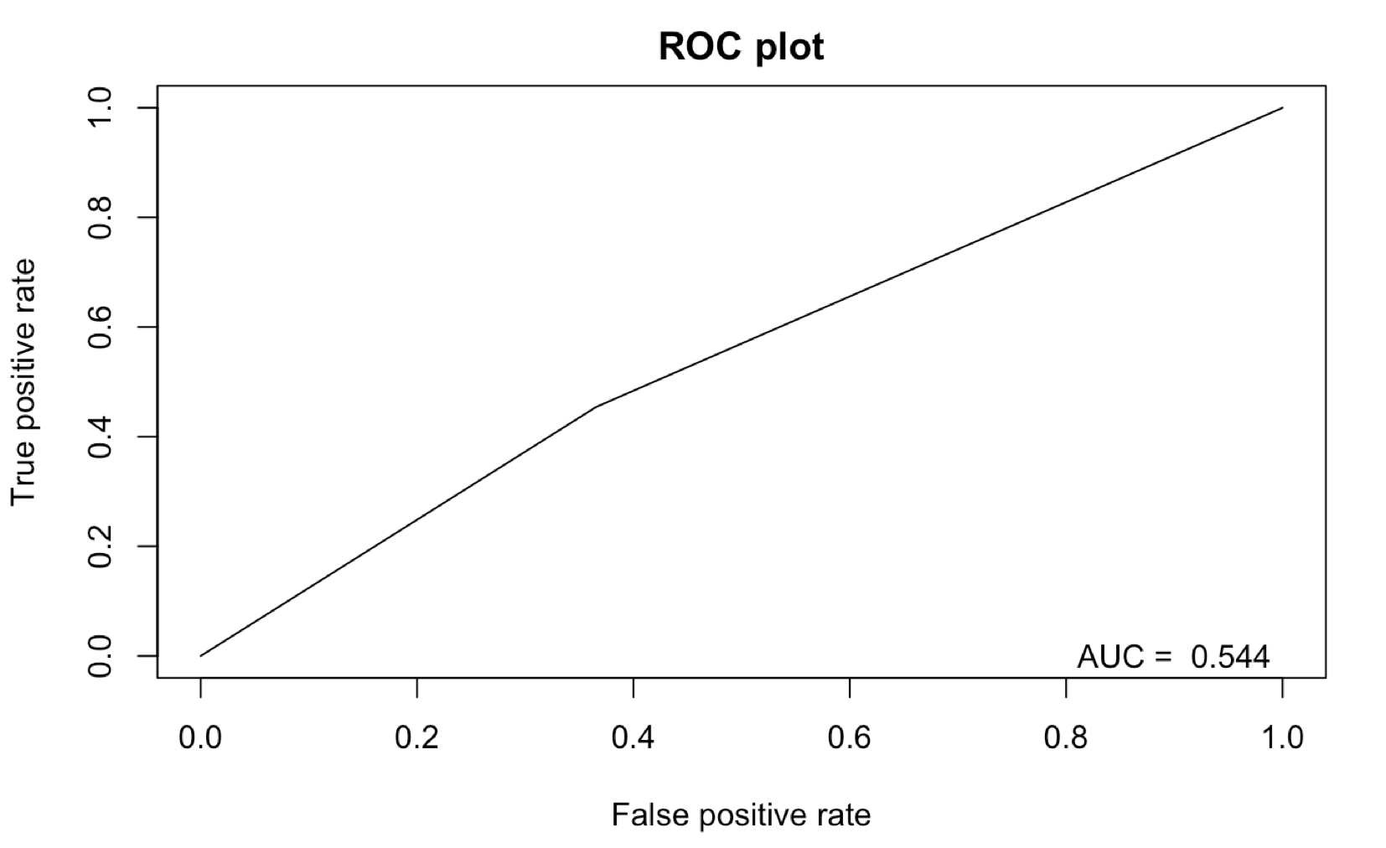
Discussion and Results
Method: kNN
Notes:
Next we implemented the k-nearest neighbors non-parametric, lazy learning algorithm, resulting in an AUC of 0.554.

Slide 17
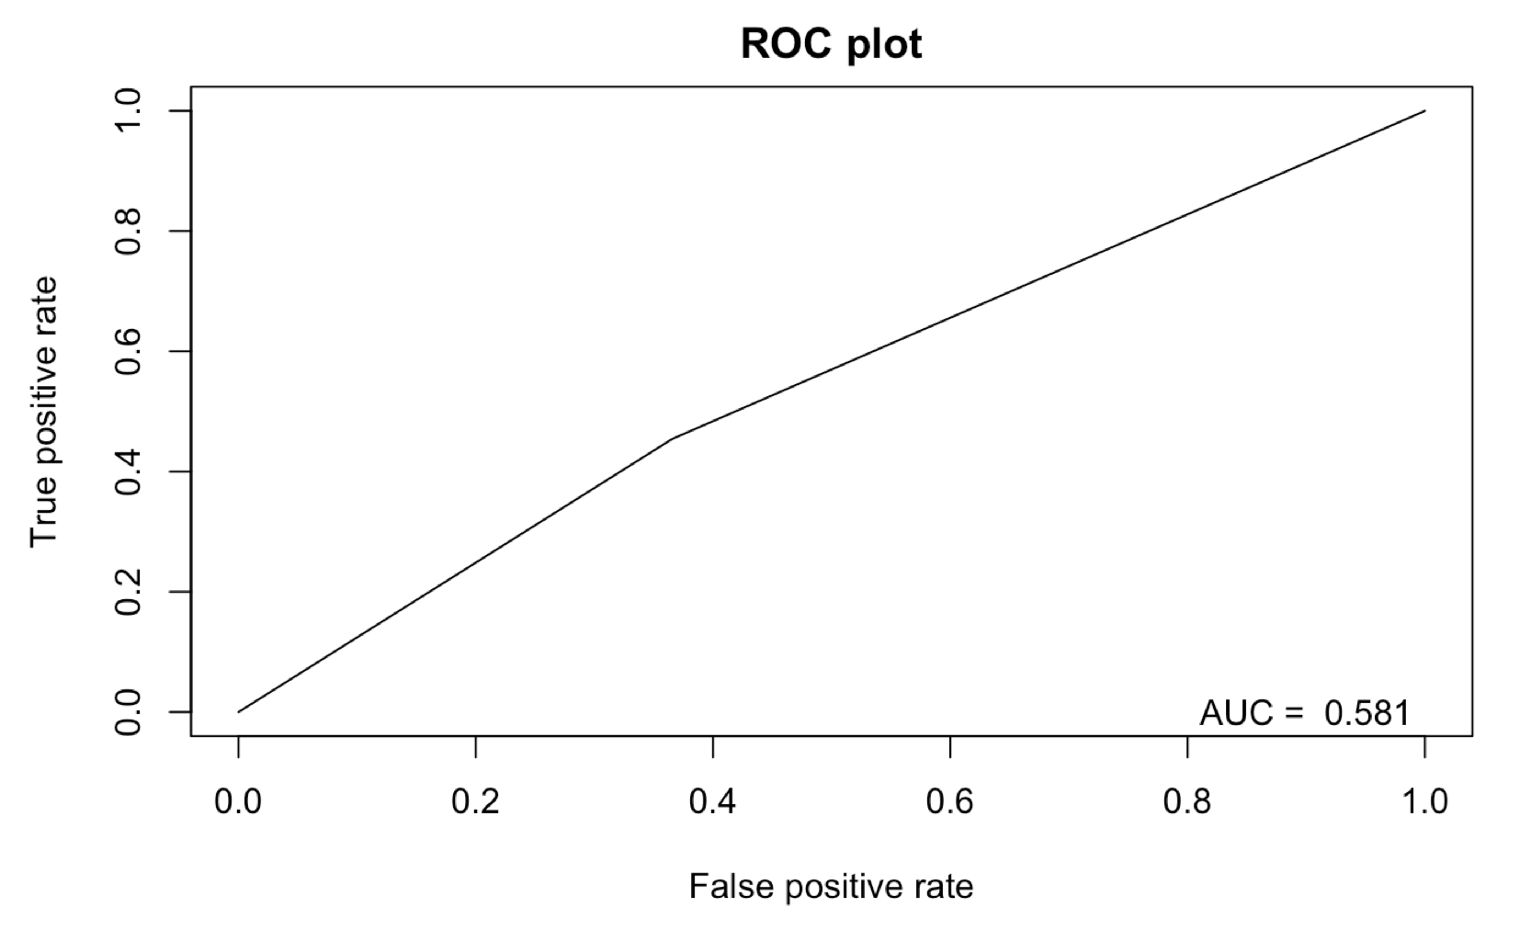
Discussion and Results
Method: GLMnet
Notes:
Next we implemented GLMnet which fits a generalized linear model via penalized maximum likelihood. To reduce noise caused by data-splitting, we used 10-fold cross-validation for tuning parameter values using the caret package. This resulted in an AUC of 0.581.

Slide 18
Conclusions
Our best performing model was XGBoost (though it had poor performance with AUC = 0.59)
While other analysis of this same dataset has produced significant results, we chose to include more features than other analyses in an attempt to better capture the whole picture of a patient’s hospital admission and health at the time of the encounter
Our results highlight the complexities of predicting readmissions while also taking into account all relevant features and confounders

Slide 19
Limitations
Databases of clinical data can present difficulties related to missing values, incomplete or inconsistent records, high dimensionality, and complexity of features
Analyzing external data is more challenging than analysis of data collected during a carefully designed study, as features that may be important may simply not be available in an external dataset
Readmission is an important yet somewhat arbitrary measure which is influenced by a potentially infinite number of factors related to a patient’s health and care received during a hospital admission

Slide 20
References
1. Strack B, DeShazo JP, Gennings C, Olmo JL, Ventura S, Cios KJ, Clore JN: Impact of HbA1c measurement on hospital readmission rates: analysis of 70,000 clinical database patient records. Biomed Res Int 2014, 2014:781670.
2. Centers for Disease Control and Prevention: National Diabetes Statistics Report, 2017. In. Edited by Centers for Disease Control and Prevention US Department of Health and Human Services. Atlanta, GA; 2017.
3. Leppin AL, Gionfriddo MR, Kessler M, Brito JP, Mair FS, Gallacher K, Wang Z, Erwin PJ, Sylvester T, Boehmer K et al: Preventing 30-day hospital readmissions: a systematic review and meta-analysis of randomized trials. JAMA Intern Med 2014, 174(7):1095-1107.
4. Rubin DJ, Handorf EA, Golden SH, Nelson DB, McDonnell ME, Zhao H: Development and Validation of a Novel Tool to Predict Hospital Readmission Risk among Patients with Diabetes. Endocr Pract 2016, 22(10):1204-1215.

Slide 21
References (R-Packages)
tidyverse
Hadley Wickham (2017). tidyverse: Easily Install and Load the 'Tidyverse'. R package version 1.2.1. https://CRAN.R-project.org/package=tidyverse
caret
Max Kuhn. Contributions from Jed Wing, Steve Weston, Andre Williams, Chris Keefer, Allan Engelhardt, Tony Cooper, Zachary Mayer, Brenton Kenkel, the R Core Team, Michael Benesty, Reynald Lescarbeau, Andrew Ziem, Luca Scrucca, Yuan Tang, Can Candan and Tyler Hunt. (2018). caret: Classification and Regression Training. R package version 6.0-81. https://CRAN.R-project.org/package=caret
xgboost
Tianqi Chen, Tong He, Michael Benesty, Vadim Khotilovich, Yuan Tang, Hyunsu Cho, Kailong Chen, Rory Mitchell, Ignacio Cano, Tianyi Zhou, Mu Li, Junyuan Xie, Min Lin, Yifeng Geng and Yutian Li (2018). xgboost: Extreme Gradient Boosting. R package version 0.71.2. https://CRAN.R-project.org/package=xgboost
skimr
Amelia McNamara, Eduardo Arino de la Rubia, Hao Zhu, Shannon Ellis and Michael Quinn (2018). skimr: Compact and Flexible Summaries of Data. R package version 1.0.3. https://CRAN.R-project.org/package=skimr
data.table
Matt Dowle and Arun Srinivasan (2018). data.table: Extension of `data.frame`. R package version 1.11.8. https://CRAN.R-project.org/package=data.table
mltools
Ben Gorman (2018). mltools: Machine Learning Tools. R package version 0.3.5. https://CRAN.R-project.org/package=mltools
corrplot
Taiyun Wei and Viliam Simko (2017). R package "corrplot": Visualization of a Correlation Matrix (Version 0.84). Available from https://github.com/taiyun/corrplot
ROCR
Sing T, Sander O, Beerenwinkel N, Lengauer T (2005). “ROCR: visualizing classifier performance in R.” Bioinformatics, 21(20), 7881. <URL: http://rocr.bioinf.mpi-sb.mpg.de>.
DMwR
Torgo, L. (2010). Data Mining with R, learning with case studies Chapman and Hall/CRC. URL: http://www.dcc.fc.up.pt/~ltorgo/DataMiningWithR
t-SNE
Jesse H. Krijthe (2015). Rtsne: T-Distributed Stochastic Neighbor Embedding using a Barnes-Hut Implementation, URL: https://github.com/jkrijthe/Rtsne
glmnet
Jerome Friedman, Trevor Hastie, Robert Tibshirani (2010). Regularization Paths for Generalized Linear Models via Coordinate Descent. Journal of Statistical Software, 33(1), 1-22. URL http://www.jstatsoft.org/v33/i01/
tableone
Kazuki Yoshida and Justin Bohn. (2018). tableone: Create 'Table 1' to Describe Baseline Characteristics. R package version 0.9.3. https://CRAN.R-project.org/package=tableone
R
R Core Team (2018). R: A language and environment for statistical computing. R Foundation for Statistical Computing, Vienna, Austria. URL https://www.R-project.org/

